Slide 1
Quality Assessment and Communicating Student Learning
Part 7
Notes:
Welcome to part 1 of the Quality Assessment and communicating student learning series.

Slide 2
Included in Part 7
Anti-Racism Education in BC
Equity and Anti-Racism in Education: Self Care
Why this work? Why now?
Culturally Responsive Pedagogy
Connecting Anti-racism work with Core and Curricular Competencies

Slide 3
Anti-Racism Education in BC
“Anti-Racism is the active process of identifying and eliminating racism by changing systems, organizational structures, policies and practices and attitudes, so that power is redistributed and shared equitably.”
Government of Canada
Notes:
As we begin this module, we think it is important to define Anti-Racism Education in BC as defined by the Government of Canada, so that we have a shared understanding of the term: “Anti-Racism is the active process of identifying and eliminating racism by changing systems, organizational structures, policies and practices and attitudes, so that power is redistributed and shared equitably.”
In our education system and teaching practices, there are ongoing challenges related to fairness and inclusivity that affect students from different marginalized backgrounds. Biases, unequal power dynamics, and systemic disparities persist, impacting students from marginalized communities. It is important to acknowledge and address these issues to promote a more equitable and empowering educational environment.
Throughout all areas of learning and grades, the BC curriculum provides many opportunities for anti-racism discussions. Including cross-curricular practices promotes a deeper and more holistic approach toward anti-racism learning for educators and students. While some BC teachers have embraced a variety of different approaches to anti-racism, others have stated they lacked the resources to teach these topics with confidence. In response to the need for additional support for these critical anti-racism topics, the Ministry of Education and Child Care worked with a development team of Indigenous, Black and People of Colour (IBPoC) teachers who represent the diversity within BC to produce an anti-racism guide for elementary and secondary school teachers.

Slide 4
Why this work? Why now?
The K-12 Anti-Racism Action Plan is a multi-year framework that has been informed by diverse voices. It will be expanded and implemented over the next several years based on the living and lived experience of racialized communities across the province.
It is currently in an early stage of implementation and many initiatives of the Action Plan are underway, including the development of professional learning and training resources to promote anti-racism awareness and education within the broader education sector.
Notes:
Since the start of the pandemic, highly publicized incidences of racism have put a spotlight on discrimination occurring on interpersonal and systemic levels. While these are not isolated incidents, this increase in public awareness has brought with it a desire for many people, especially young people, to better understand racism and discrimination and to learn more about the roles we can play in addressing these ongoing issues.
It is vital for younger generations to learn about discrimination and how it has impacted – and continues to impact – people throughout BC. By understanding the realities of racism, we can continue on a positive path forward, with young people as part of the solution toward making a more equitable and welcoming province for everyone.

Slide 5
The British Columbia Teachers Council (BCTC) Professional Standards were updated for BC Educators in 2019 to include a 9th professional standard which states:
“Educators respect the value and history of First Nations, Inuit and Métis in Canada and the impact of the past on the present and the future. Educators contribute towards trust, reconciliation and healing. Educators foster a deeper understanding of ways of knowing and being, histories, and cultures of First Nations, Inuit and Métis.”
Notes:
In 2019, The British Columbia Teachers Council (BCTC) Professional Standards were updated for BC Educators to include a 9th professional standard which states:
“Educators respect the value and history of First Nations, Inuit and Métis in Canada and the impact of the past on the present and the future. Educators contribute towards trust, reconciliation and healing. Educators foster a deeper understanding of ways of knowing and being, histories, and cultures of First Nations, Inuit and Métis.”
The implications of this standard requires every educator to commit to this work in their practice and context. It's important to acknowledge that educators may be at different points with this work, and identify where one is and continue to grow and move towards where they need to be next.

Slide 6
Equity and Anti-Racism in Education: Self Care
Engaging in anti-racist and equity work can evoke challenging emotions, and we need to have strategies to step thought the discomfort of this work and to acknowledge and manage the emotions that may arise. These strategies are crucial for maintaining well-being while actively participating in this transformative process.
Deep breathing and Grounding
Mindful Awareness
Practice Active Listening and Empathy
Seek Support and Build Community
Engage in Self-Reflection and Emotional Processing
Set and Respect Boundaries
Notes:
Engaging in anti-racist and equity work can evoke challenging emotions, and we need to have strategies to step thought the discomfort of this work and to acknowledge and manage the emotions that may arise. Some in the moment strategies include:
Deep breathing and Grounding
Mindful Awareness
Practice Active Listening and Empathy
And some larger ongoing practices include:
seeking support from a community, engaging in self-reflection, and setting boundaries,
All of these are crucial for maintaining well-being while actively participating in this transformative process.
You may want to pause here and refer to the Equity and Anti-Racism in Education Self Care document for detailed information about these strategies.

Slide 7
Notes:
As mentioned in previous modules, The Circle of Courage, a model of positive youth development created by Dr. Martin Brokenleg and team, is an iteration of the First Peoples' Medicine Wheel, holds significant purpose in education, particularly in the context of anti-racism efforts, and is explicitly referenced in the K-12 reporting policy document.
By emphasizing the core values of Belonging, Generosity, Mastery, and Independence, it aims to create an inclusive and equitable learning environment and foundational principles for holistic growth and well being.
In the context of assessment, teachers can make curriculum choices, design learning experiences and assessments that promote the growth and well being of their learners.

Slide 8
Notes:
The purpose of the Circle of Courage in education is to create a holistic and supportive learning environment where students' social, emotional, and cognitive needs are met.
Belonging refers to the need for individuals to feel connected, valued, and included within their communities. In the context of assessment, culturally responsive anti-racism efforts should aim to create an inclusive environment where all students feel a sense of belonging. This can be achieved by using assessment methods that recognize and value diverse cultural backgrounds, allowing students to express their unique perspectives, and fostering a supportive and inclusive classroom climate.
Generosity involves acts of kindness, empathy, and giving back to others. In the context of assessment, generosity can be promoted by encouraging students to collaborate, support each other, and share their knowledge and experiences. Assessment tasks can be designed to encourage students to engage in cooperative learning, peer feedback, and opportunities for students to share what they know and what they can do in a way that is a strength of theirs.
Mastery: Mastery refers to the development of competence, skills, and knowledge in various domains. In assessment, mastery can be promoted by ensuring that assessments are fair, relevant, transparent and aligned with culturally diverse perspectives. It is important to provide many opportunities for students to demonstrate their knowledge and skills in multiple ways, considering different learning styles and cultural backgrounds.
Independence: Independence refers to the ability of individuals to make choices, take responsibility for their learning, and develop self-confidence. In the context of assessment promoting independence means empowering students to take ownership of their learning and assessment processes. This can be achieved by involving students in the assessment design, encouraging self-reflection, and providing opportunities for student voice and choice in assessment methods.

Slide 9
Notes:
Please refer to this slide, or the printed resource during the pause and table talk discussions in the next slide.

Slide 10
PAUSE
Please refer to the 4 A's document and table talk the following questions:
What are you, as a classroom teacher, and your school community already doing to develop the 4 quadrants of the Circle of Courage with your students?
What additional ideas does your group have to add to each quadrant?
Notes:
The goals of education aren't just limited to teaching students skills and content, but also the development of human beings. Teachers, admin. And support workers do this in very practical ways and sometimes unconsciously. The Ministry has embedded the ideas of the four quadrants of the circle of courage in the Redesigned curriculum as well as in the Reporting Policy. Please refer to the Minstry's 4A's document to reflect and share the practical ways you are developing the 4 quadrants of the Circle of Courage with your students with your assessment and in other ways in your school community?
Please pause the video at this time and table talk with the following questions.

Slide 11
Culturally Informed Assessment Practices
"All assessment practices should foster holistic development of the whole person by honouring and incorporating students' cultures and encouraging self-determination, self-identity and self-actualization."
-K-12 Student Reporting Policy, p.12
Notes:
The principles of the Circle of Courage are included in the foundation of the redesigned curriclum and The K-12 Student Reporting policy. In fact, the policy clearly states that "all assessment practices should foster holistic development of the whole person by honouring and incorporating students' cultures and encouraging self-determination, self-identity and self-actualization."
While culturally informed assessment practices provide a starting point, it is crucial to go a step further shift towards culturally responsive assessment to truly address biases, promote inclusivity, and ensure fair representation for individuals from diverse cultural backgrounds.

Slide 12
Culturally Responsive Pedagogy
Culturally responsive pedagogy includes practices that are inherently anti-racist in education.
It acknowledges and values the cultural backgrounds, lived experiences, and knowledge of students, recognizing that these aspects play a crucial role in their learning.
It involves incorporating culturally significant content, examples, and perspectives into the curriculum to make learning more meaningful, relatable and relevant for students and thereby fostering academic success and positive identity development.
Emphasizes the teacher's role in actively engaging with students' cultural backgrounds, perspectives, and lived experiences, and in turn teachers make choices that reflect and connect to students' backgrounds, histories, experiences, and cultural contexts.
By valuing and incorporating students' diverse cultural backgrounds, experiences, and perspectives, this approach actively challenges and combats racism within the educational system.
These practices promote equity, inclusivity, empowerment, and overall well-being by honoring the identities and knowledge of all students, dismantling systemic biases, and ensuring fair and culturally relevant assessments.
Notes:
Culturally responsive pedagogy is an educational approach that embraces anti-racist practices. It recognizes and appreciates the cultural backgrounds, life experiences, and knowledge of students as vital components of their learning journey. By incorporating culturally significant content, examples, and perspectives into the curriculum, this approach aims to make learning more meaningful, relatable, and relevant for students, fostering academic success and positive identity development. Additionally, it highlights the active role of teachers in engaging with students' cultural backgrounds, perspectives, and experiences, encouraging them to make choices that reflect and connect to students' diverse backgrounds, histories, and cultural contexts. By valuing and incorporating these diverse elements, culturally responsive pedagogy actively challenges and confronts racism within the educational system. Furthermore, these practices promote equity, inclusivity, empowerment, and overall well-being by honoring the identities and knowledge of all students, dismantling systemic biases, and ensuring fair and culturally relevant assessments.

Slide 13
Equitable & Culturally Responsive Assessment Practices
Anti-racism in education means actively combating and eradicating systemic racism in schools. It focuses on ensuring fair opportunities and outcomes for all students, regardless of their race or ethnicity. This involves recognizing and addressing racism in various aspects of education, including systems, policies, curriculum, school processes, teaching methods, and interactions.
Culturally Responsive Teaching
Anti Bias Curriculum
Diverse Representation
Professional Development
Supportive and Inclusive Classroom, School, and work Environments
Parent and Community Engagement
Continuous Self- Reflection
Notes:
In the education context, anti-racism refers to a commitment to actively challenging and dismantling systemic racism within educational institutions and promoting equitable opportunities and outcomes for all students, regardless of their racial or ethnic background. It involves recognizing and addressing the ways in which racism operates within educational systems, policies, curriculum, school processes and procedures, teaching pedagogical choices, practices, and interactions

Slide 14
PAUSE
Personal Reflection:
A move towards building a more equitable, inclusive, and culturally responsive education system for all learners, requires us to closely examine our practices and processes.
Please refer to the Equity and Culturally Responsive Assessment Practices: document and engage in personal reflection time. Consider your curriculum and assessment practices and identify what you are already doing, and 1 or more areas that you would like to explore and implement.
Notes:
Please Pause the video at this time and engage in personal reflection time with the Equity and Culturally Responsive Assessment Practices document. This document shares information and some strategies relating to a move towards building a more equitable, culturally responsive and inclusive education system for all learners.
*****************************************
How can schools implement practical strategies to address systemic racism, promote antiracism, and foster equity, while creating a more inclusive environment that values and respects diverse cultures, backgrounds, and identities?

Slide 15
Curriculum Design and Assessment
If we don't consciously identify and address our own biases, assumptions, or ways to make our curriculum design and assessment anti-racist and culturally responsive, we are inadvertently:
Perpetuating systemic inequities
Excluding students that are not from the dominant culture, students who are racialized and students with language proficiency challenges
Rewarding memorization of facts that align with colonial histories while misrepresenting, overlooking, or erasing the histories of other people and cultures.
Notes:
In order to shift to culturally responsive assessment practices, we also need to critically analyze our existing curriculum design and assessment practices.
If we don't consciously make that shift in our design and our approach, then our own biases and assumptions about learning can be communicated directly and indirectly through our assessment design, indirectly excluding students that are not from the dominant culture, students who are racialized and students with language proficiency challenges.

Slide 16
PAUSE
The shift to culturally responsive curriculum design and assessment is an active process, and not simply a matter of re-writing a question.
It's an approach and lens through which the teacher would set up the learning experience as an authentic exploration, scaffolded to guide students so that they feel confident with the task.
Please refer to the "Shift to Culturally Responsive Learning Explorations" document and engage in table talk with your department members for the samples provided.
Consider a project, assignment, task, or question that you engage your students in every year. How can you rewrite it with a culturally responsive lens?
Notes:
Please Pause the video at this time and engage in table talk discussions with the following question.
The shift to culturally responsive curriculum design and assessment isn't simply a matter of re-writing a question, it's an approach and lens through which the teacher would set up the learning experience so that it is an authentic exploration, scaffolded to guide students so that they feel confident with the task.

Slide 17
Culturally Informed Assessment Practices
"The goal of the learning partnership is to help students become more actively engaged in their own learning... If you create the right conditions of care and challenge as a warm demander, students will rise to the occasion." (Hammond, p.106)
Notes:
In her book, Culturally Responsive Teaching and the Brain, Zaretta Hammond describes the importance of having a two-way alliance with students and a reminder that the challenge of moving dependent learners forward doesn't all rest on you. Rather, it is a learning partnership where we as educators make a shift in thinking about the tools, tactics and techniques we need to gather and develop in order to be culturally responsive within the learning partnership. Culturally responseive assessment practices allow students flexibility during assessments so they can bring their own cultural identities into demonstrations of their learning.

Slide 18
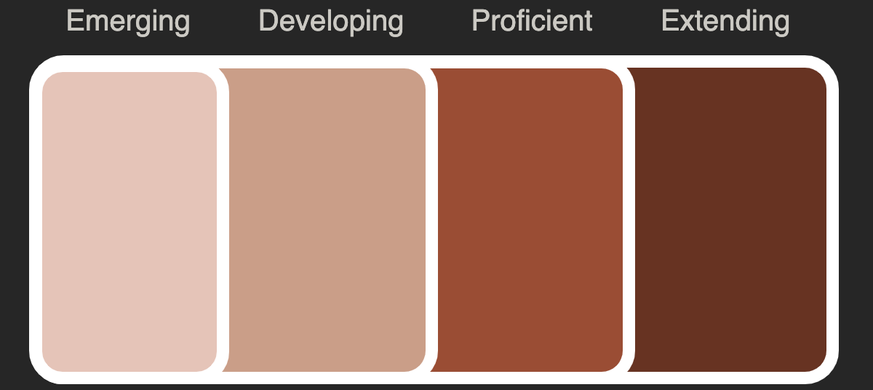
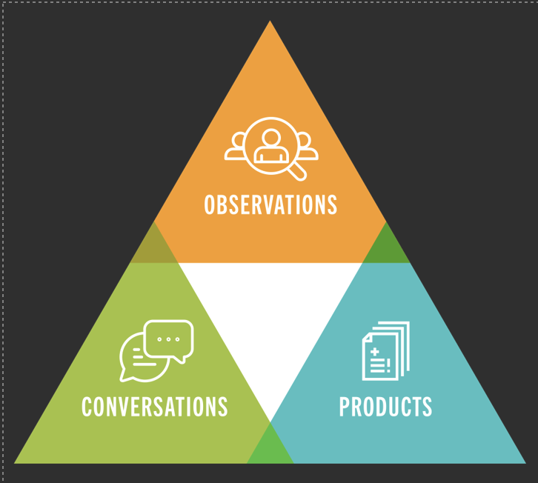
/CREATE PROFICIENCY SCALES
& REPORTING
Notes:
For a long time our assessment has focused on the product and Some students might show their strength in another part of the learning process and not just in the end product. Triangulating evidence of learning honours the learning in the way that it exists for each student. As mentioned before, once our criteria is clear for a learning standard it allows us the opportunity to capture evidence of that criteria in a variety of ways.

Slide 19
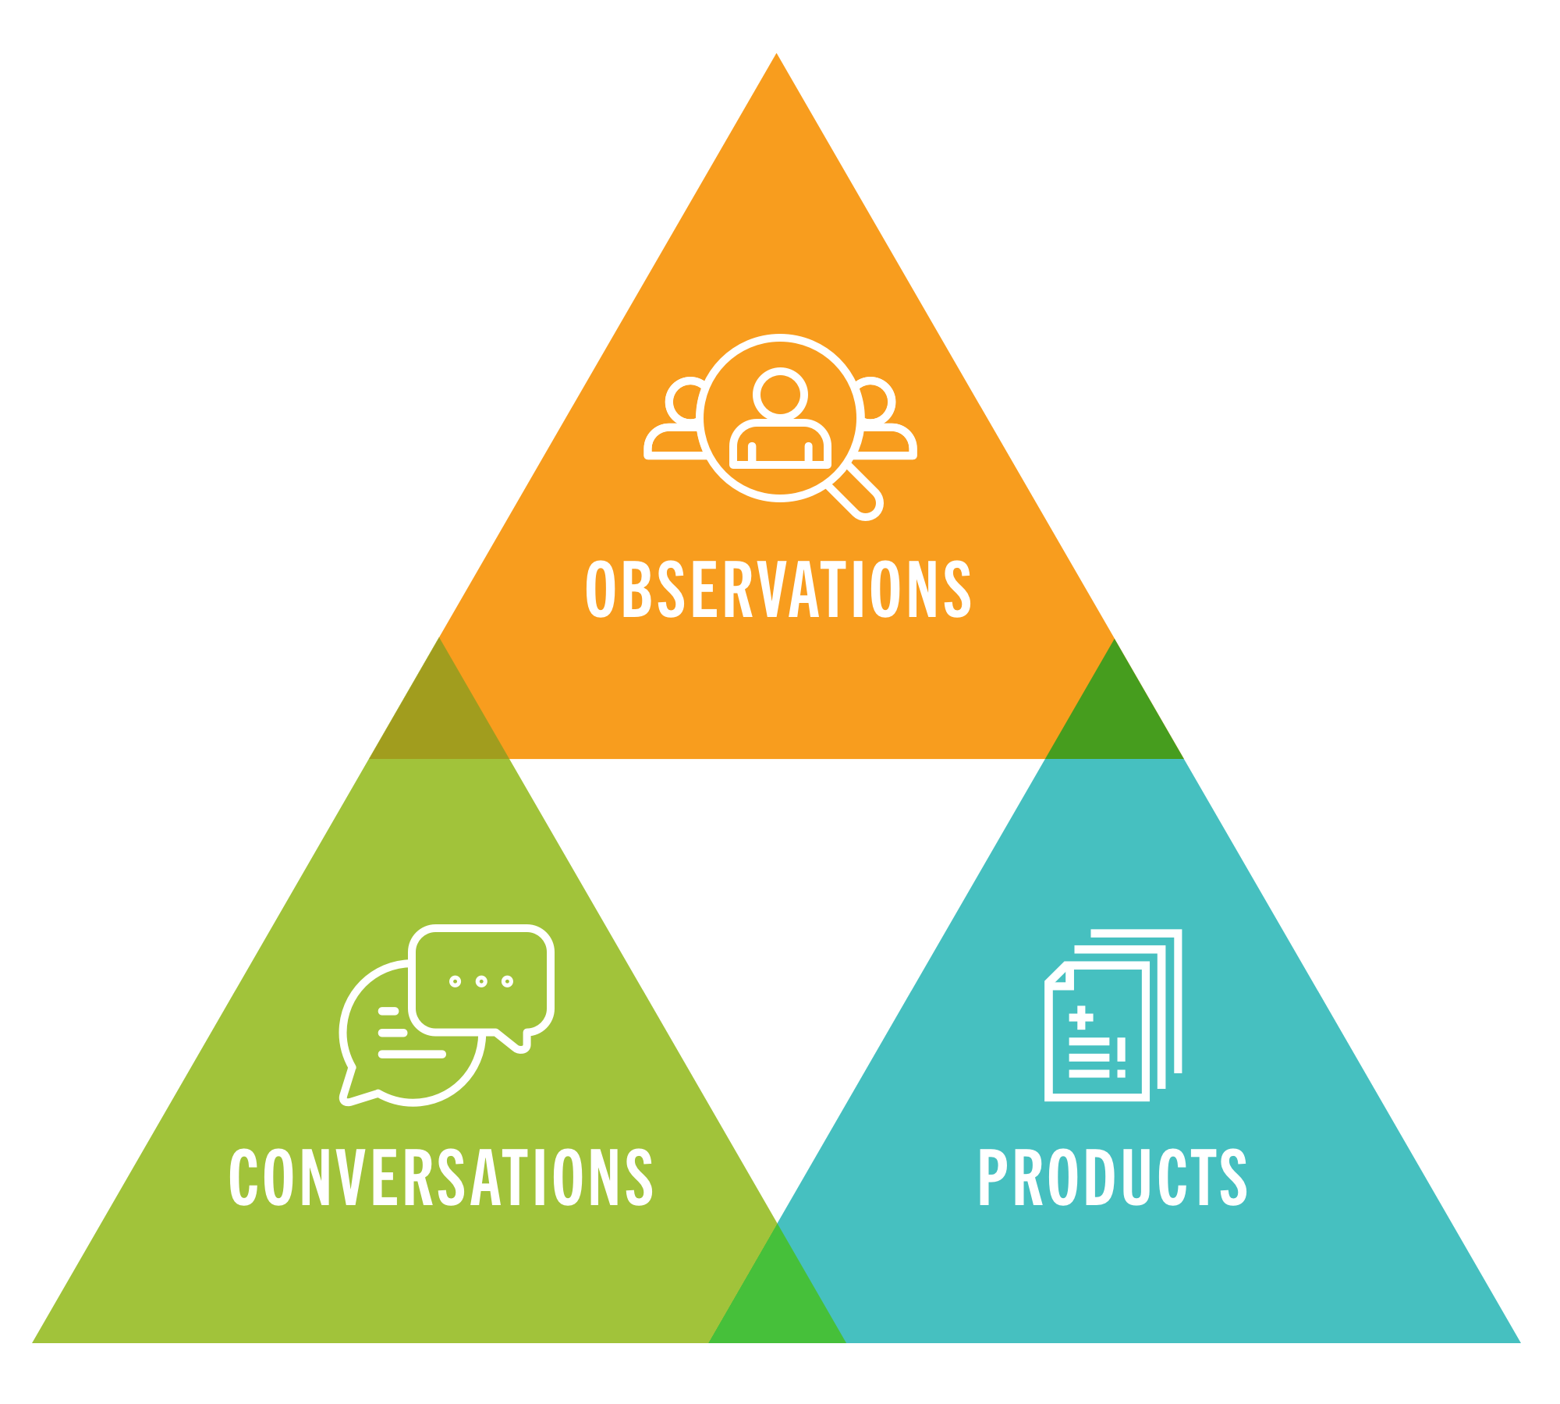
Triangulating Evidence of Learning
Observations
Group discussions
Independent work
Collaborative projects
Rehearsals
Daily learning
Products
Performances
Presentations
Portfolios
Project based, Inquiry approaches
Recordings
Artwork
Critiques/reviews
Self and peer reflections & assessments
Assignments
Conversations
Oral Assessments
Oral Storytelling
Experiential land-based learning
Personal Narratives
Conferences
Interviews
Group discussions
Whole class discussions
Class meetings
One on one conversations
Notes:
Triangulating evidence of learning is considered a culturally responsive assessment practice because it recognizes and values diverse forms of knowledge and ways of demonstrating understanding. It goes beyond relying on a single assessment method or source of information to make judgments about student learning.
This approach aligns with culturally responsive pedagogy by acknowledging that students from different cultural backgrounds may have unique ways of expressing their learning and understanding. It allows for flexibility and openness to diverse forms of communication, expression, and representation.

Slide 20
"Education must embrace racial equity and be culturally inclusive to ensure that all students and staff have an environment that recognizes and honours their dignity, humanity, and potential, which supports the creation of a future that is free of racism. Wider societal change is required to support equitable and inclusive education for all students."
Notes:
Education must embrace racial equity and be culturally inclusive to ensure that all students and staff have an environment that recognizes and honours their dignity, humanity, and potential, which supports the creation of a future that is free of racism. Wider societal change is required to support equitable and inclusive education for all students.
In the next few slides we will share ways in which the BC curriculum provides opportunities for an integrated anti-racism approach.
This information comes from the 'Anti-Racism: A Guide for Educators' provided by the Ministry of Education and Childcare. It is included in this modules resources and a great starting point to see the explicit connections between our curriculum and anti-racism – included in the document are specific examples of anti-racism in the curricular competencies from different areas of learning K-12 and specific strategies to explore and ground the work.

Slide 21
This document is not meant to be a step-by-step manual. Instead, it is meant to provide teachers with a useful starting point for teaching various anti-racism topics in all areas of learning. It contains an anti-racism Teaching Guide, which can be adapted to meet the needs of the local community and students. While this guide contains helpful advice and suggestions, teachers will need to adapt to the needs of their students, and other factors unique to their school and classroom contexts.
As part of the comprehensive approach to anti-racism, teachers are encouraged to treat these conversations as part of ongoing dialogue in the classroom rather than a once-a-year event. Many schools have relied on presentations by anti-racism workshops to cover these important conversations as a reaction to an incident. Ongoing learning and teacher-mediated discussions about anti-racism can help cultivate a culture of equality that become a normalized part of school cultures.
As students become more familiar and comfortable with talking about these issues, they may have questions that come up throughout the year that cannot be adequately answered during a one-time presentation. Having classroom teachers address these topics also contributes to the overall goal of helping normalize conversations about anti-racism.
Notes:
This document is not meant to be a step-by-step manual. Instead, it is meant to provide teachers with a useful starting point for teaching various anti-racism topics in all areas of learning. It contains an anti-racism Teaching Guide, which can be adapted to meet the needs of the local community and students. While this guide contains helpful advice and suggestions, teachers will need to adapt to the needs of their students, and other factors unique to their school and classroom contexts.
As part of the comprehensive approach to anti-racism, teachers are encouraged to treat these conversations as part of ongoing dialogue in the classroom rather than a once-a-year event. Many schools have relied on presentations by anti-racism workshops to cover these important conversations as a reaction to an incident. Ongoing learning and teacher-mediated discussions about anti-racism can help cultivate a culture of equality that become a normalized part of school cultures.
As students become more familiar and comfortable with talking about these issues, they may have questions that come up throughout the year that cannot be adequately answered during a one-time presentation. Having classroom teachers address these topics also contributes to the overall goal of helping normalize conversations about anti-racism.

Slide 22
Connecting Anti-Racism work with Core Competencies
Core competencies in British Columbia's K-12 education system shape student learning outcomes and include critical thinking, effective communication, and personal/social responsibility.
Connecting anti-racism work with core competencies integrates equity, inclusivity, and anti-racism to address systemic racism and create a more inclusive learning environment.
Intentional integration of anti-racism with core competencies empowers students to be critical thinkers, effective communicators, and socially responsible individuals who challenge racism and promote equity.
Notes:
In British Columbia's K-12 education system, the concept of core competencies plays a significant role in shaping student learning outcomes. Core competencies are a set of essential skills, attitudes, and knowledge that students develop throughout their education to help them thrive in life, learning, and work. These competencies include thinking critically, communicating effectively, and engaging in personal and social responsibility.
Connecting anti-racism work with core competencies involves integrating the values of equity, inclusivity, and antiracism into the development of these competencies. By doing so, the education system can actively address and challenge systemic racism while fostering a more inclusive and equitable learning environment for all students.
By intentionally integrating antiracism work with core competencies, the education system in British Columbia can empower students to become critical thinkers, effective communicators, and socially responsible individuals who actively challenge racism and promote equity and inclusivity in their communities and beyond.

Slide 23
Connecting Anti-racism work with Curricular Competencies
Anti-racism is applicable to all areas of learning and is not the responsibility of any one teacher or teachers of specific grade levels or curricular areas. While it is true that some anti-racism work might be more accessible or explicit in some areas of learning, there are relevant ways to apply an anti-racist lens across the curriculum and challenge understandings across the entire school community.
Notes:
Anti-racism is applicable to all areas of learning and is not the responsibility of any one teacher or teachers of specific grade levels or curricular areas. While it is true that some anti-racism work might be more accessible or explicit in some areas of learning, there are relevant ways to apply an anti-racist lens across the curriculum and challenge understandings across the entire school community.

